Slide 1

Welcome to the Legal Services Board Stakeholder Engagement Event

Slide 2
Agenda
Welcome from:
David Sanders, Director of Risk, Clarke Willmott
Alan Kershaw, Chair LSB
Presentation: Richard Orpin, Director of Policy and Regulation.
Discussion on topics of interest
    Consumer Protection (covering issues raised about SRA/LeO)
    Access to justice
    The role of the unregulated sector – opportunities and risks
    Building a strong regulated sector – role of regulation, lawtech
Q+A, facilitated by Alan Kershaw
Networking and coffee/tea

Slide 3
      Richard Orpin
Introducing the LSB
17 September 2024

Slide 4
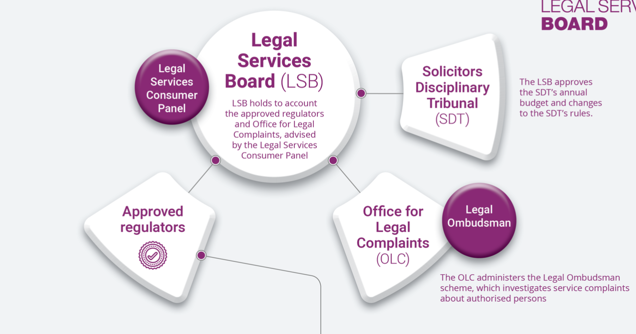

Legal Services Board

Slide 5
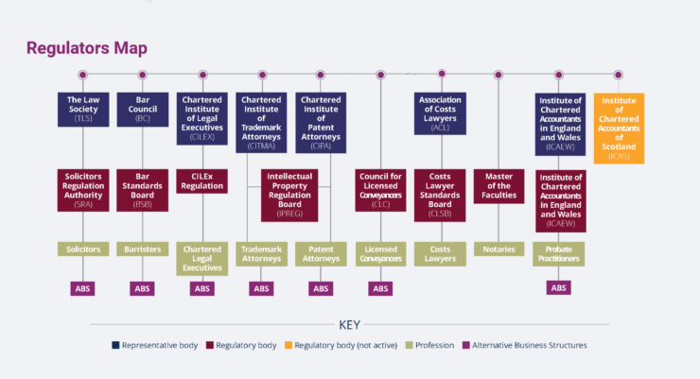
Regulators map

Slide 6
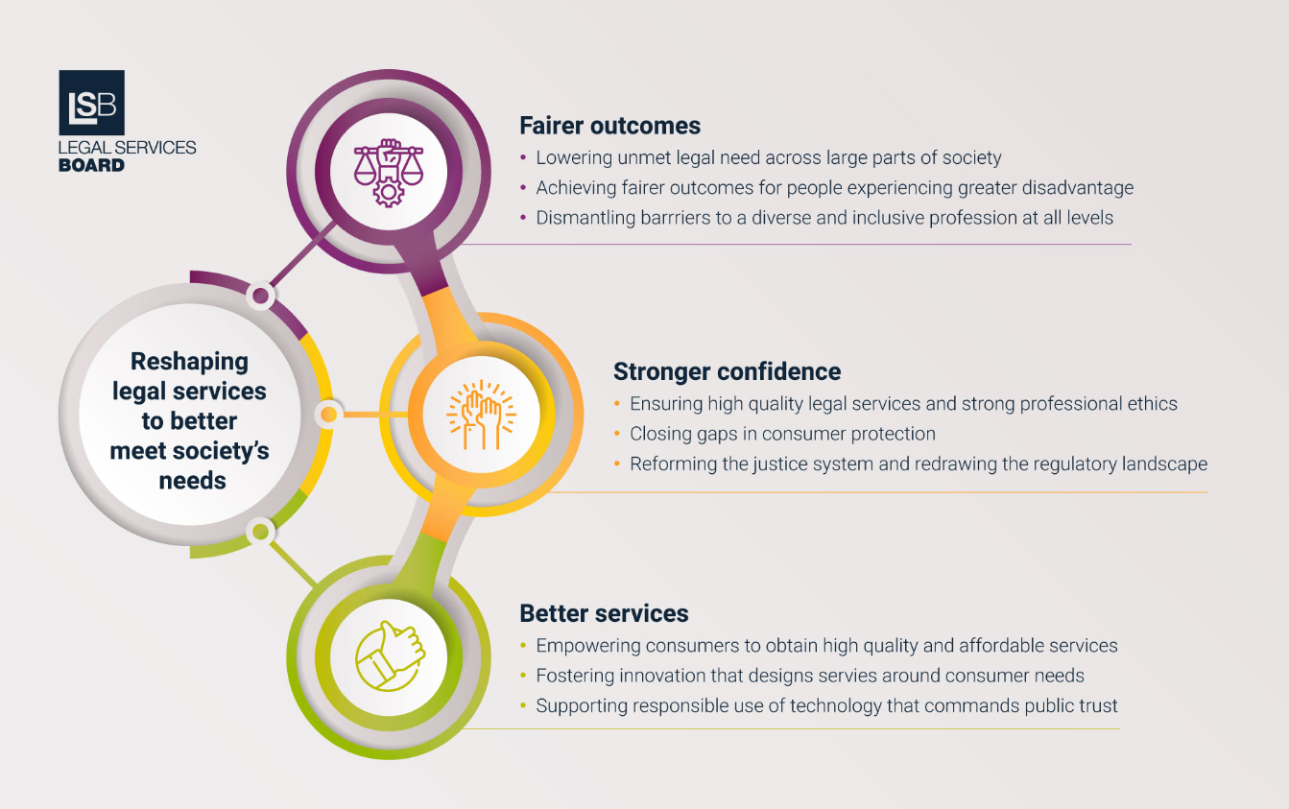
Reshaping legal services

Slide 7

Key areas of work in 2024/25
Workstream | Key activities in 2024/25
Equality, diversity and inclusion | Develop a policy statement on equality, diversity and inclusion to maximise the role of regulation in removing barriers to a diverse and inclusive profession.
Rule of law and professional ethics | Ensure regulation supports upholding the rule of law and professional ethics, including supporting the new regulatory objective to promote the prevention and detection of economic crime.
Disciplinary and enforcement processes | Ensure regulators’ approaches to disciplinary and enforcement processes build public confidence and uphold standards.
Technology and innovation | Consider the role of regulation in ensuring safe uses of artificial intelligence (AI) that benefit legal services users as part of our work on technology and innovation. We will also support the regulators to deliver a regulatory information service with the functionality of a single digital register.
Review of LSB education and training guidance | Evaluate the Education and Training Guidance, considering implications of our ongoing competence, PERL and EDI work.
7

Slide 8
Key areas of work in 2024/25
Workstream | Key activities in 2024/25
Consumer Vulnerability | Make the case for a strategic approach to consumer vulnerability and user design in legal services.
Evaluation of IGR | Evaluate the operation and effectiveness of the Internal Governance Rules (IGR) and guidance, a commitment we made when we implemented the current IGR in 2019.
Market surveillance | Enhance our market surveillance and horizon scanning capability, including for example, climate change as an area of focus to help stay informed of potential future impacts.
Review of LSB enforcement policy | Evaluate the LSB’s statement of policy on taking enforcement action, ensuring that it aligns with our regulatory approach.
Access to justice | Consider the role of regulation in improving access to justice.
Curating the Strategy | Maintain momentum on the strategy within the sector through our curating the strategy project, including the Reshaping Legal Services microsite and our next annual conference.
8

Slide 9
Individual Legal Needs Survey
17,668 adults in England and Wales
Survey asks about 34 different types of legal issue in the last four years
Applies OECD framework for estimating legal needs
Uses standardised measures of legal capability
n: 4,381 (contentious and non-contentious issues)
Notes:
Joint with Law Soc. Provides key stats on access to justice. Design means can ID when participants have a legal issue and a legal need even if they don't know. Legal capability measures are on ability as a consumer to use and navigate level services.
The survey asks whether people have experienced one or more of 34 different types of legal issue in the last four years, for example divorce or buying a property

Slide 10
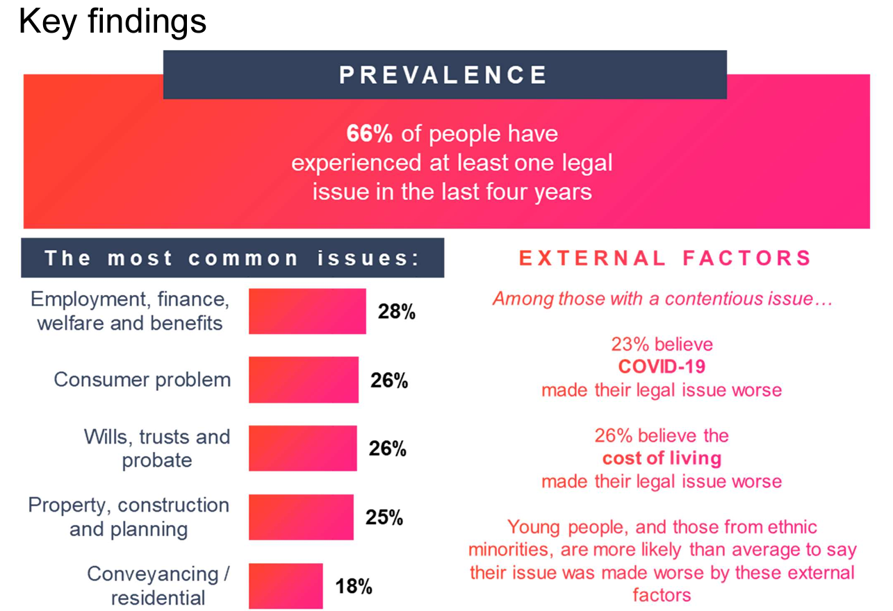
Individual Legal Needs Survey
Notes:
The single most common issue (26%) of all issues are with defective goods or services, the most common category of issues are to do with employment, finance, welfare and benefits. You can also see the very low incidence but high stakes issues like property repossession, immigration etc.

Slide 11
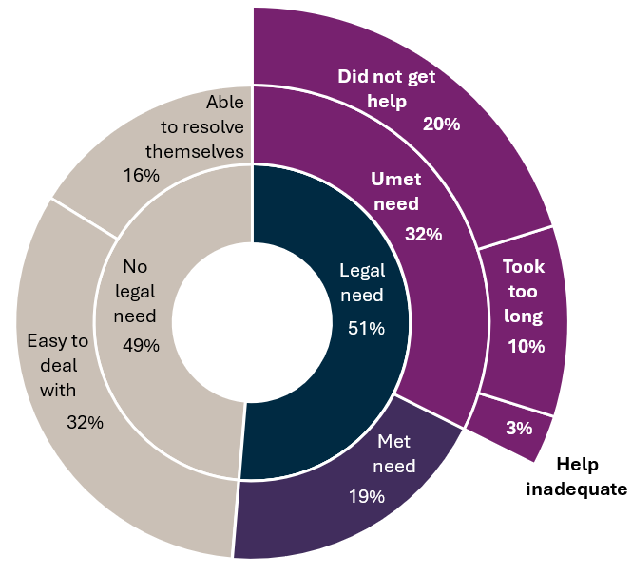
Unmet needs
Looking at the experience of those with a resolved contentious legal issue:
N:7,026 (concluded contentious legal issues E&W)
Notes:
Our 2023 Individual Legal Needs Survey shows that in England & Wales 2/3 experience at least 1 legal issue over a four year period and of those experiencing a contentious legal issue 32% have an unmet legal need.
Two-thirds (66%) of people within the initial incidence sample have reported experiencing a legal issue within the last four years, representing a two percentage point increase since the 2019 survey
Likewise, there has also been a sizeable increase since the 2019 survey in the proportion of people who have experienced a contentious issue, rising by four percentage points to 57% in 2023.
Legal issues: A problem issue or question that can be resolved or answered by law. The research asked people if they had experienced one or more of 34 different legal issues such as divorce or buying a property (full list provided in technical report).
Contentious legal issues: Contentious legal work relates to legal matters that take place when there is a dispute between two or more parties, which can involve mediation, arbitrations, courts, and tribunals.
Non-contentious legal issues: Non-contentious legal work relates to transactions occurring between parties where there is not a dispute, such as the sale or purchase of a house, or advisory work

Slide 12
Reasons for not getting help
n: 4,381 (contentious and non-contentious issues)
Notes:
As from last slide main reason for unmet need is not getting help. Notable reasons include no one who could help (29% for contentious and non contentious issues) or assuming too expensive (18%).

Slide 13
Key differences between the South West and the national average
Question | Total Score | South West | Difference
Type of legal issue: Dealt with an estate of someone that has died | 29% | 34% | +5%
Shopping around: Found it quite difficult to search for reviews | 10% | 16% | +6%
Shopping around: Found it quite difficult to use cost comparison websites | 8% | 14% | +6%
Unmet legal need | 32% | 33% | Not Signif. different
Notes:
There were mostly minimal differecnes between the South West and the rest of the UK. Out of the differences that existed, most can be explained by age and income differences that exist in the South West comapred to the rest of the UK. The older slightly more affluent population differences can explain some of the differences seen in this table.

Slide 14
Legal Services Board
Thank you

